Slide 1
“Where should I locate
my new office?”
Team TLDR
Jason Deng, Sophia Shen, Kevin Tao, Lucy Wang, Thomas You
Notes:
"Where to Work: Predicting Office Location Decisions in Tech, Law, and Finance"
"Smart Space: A Data-Driven Guide to Leasing Decisions Across Industries"
"Location, Location, Logic: Using Machine Learning to Guide Corporate Leasing"
"The Right Place to Grow: Sector-Based Insights on Office Site Selection"
"Office Intelligence: Predicting Ideal Locations for Tech, Finance, and Law Firms"
"Beyond Rent: What Really Drives Office Location Choices Across Sectors"
"Rooted in Data: Mapping the Future of Corporate Office Locations"
"Tailored by Sector, Powered by Data: A Leasing Location Model for the Modern Firm"

Slide 2
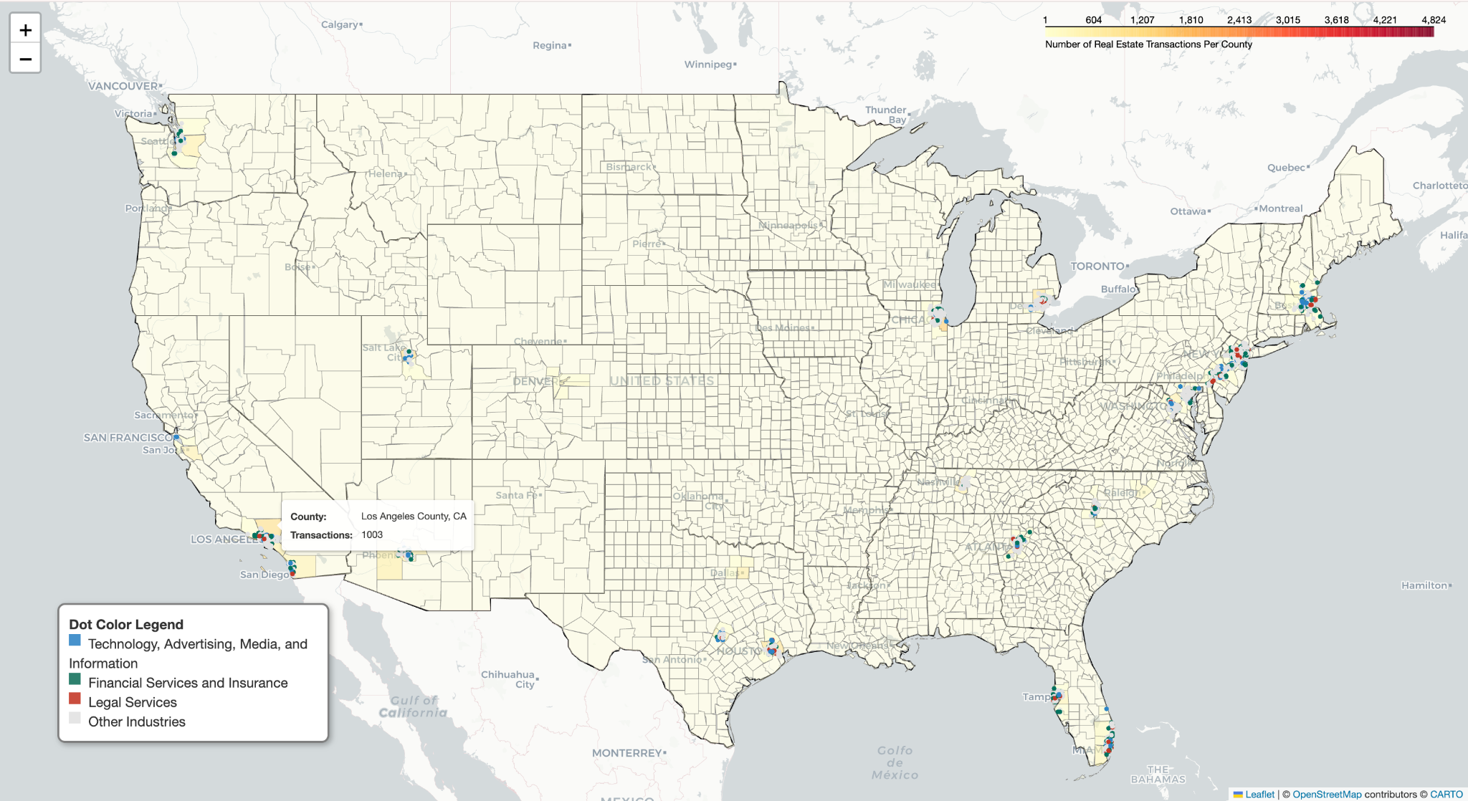
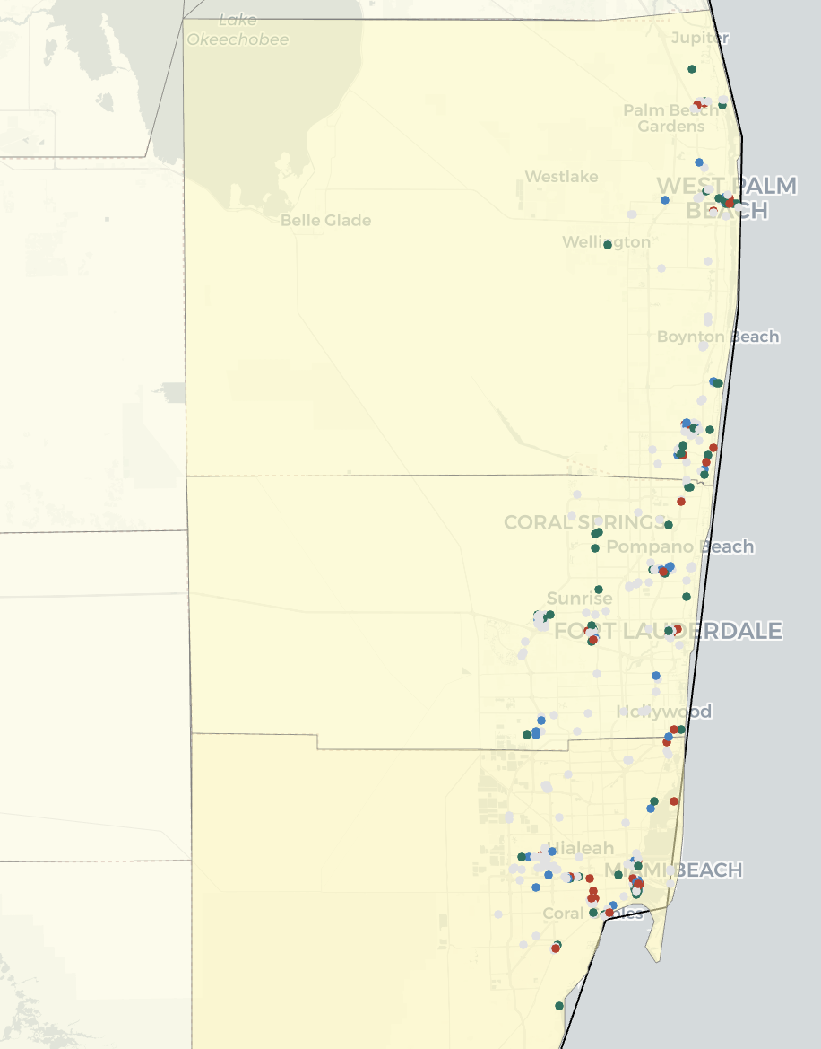
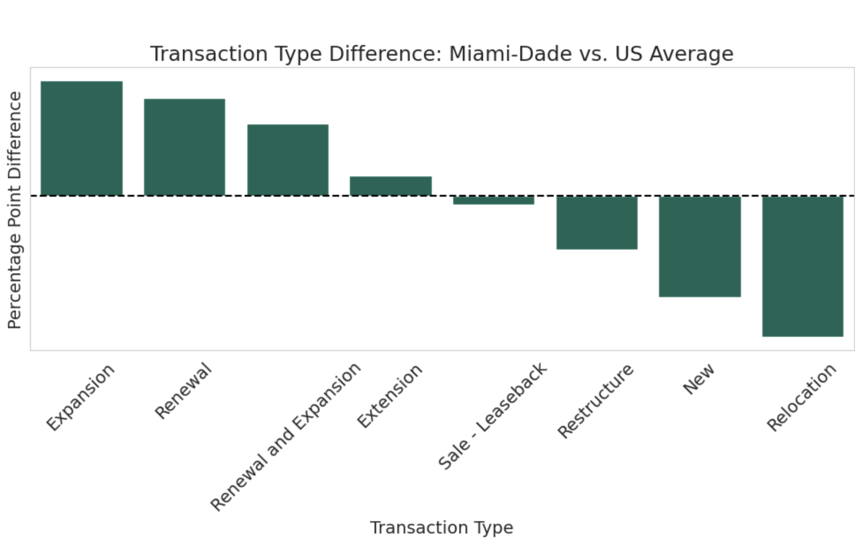
Zoom-in for Southeast Miami

Slide 3
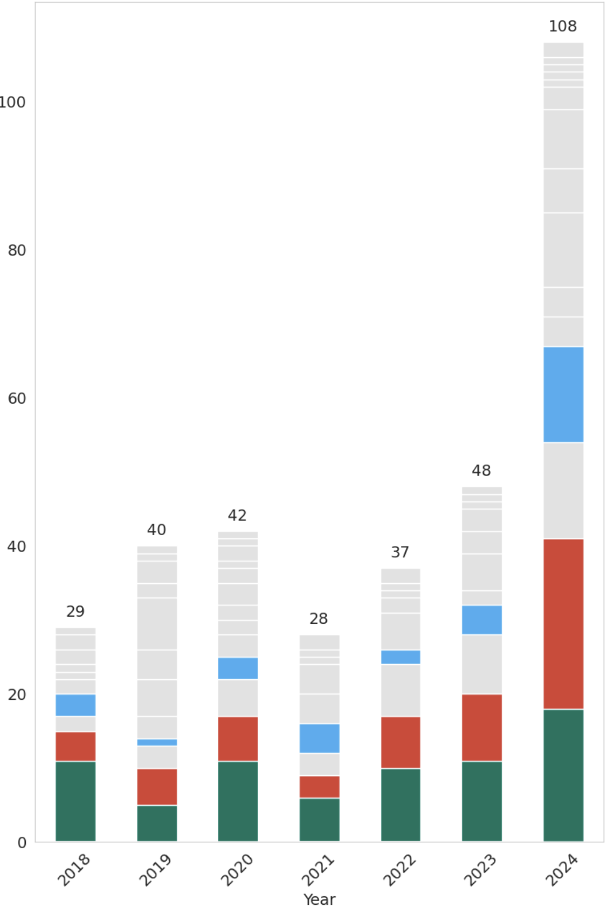
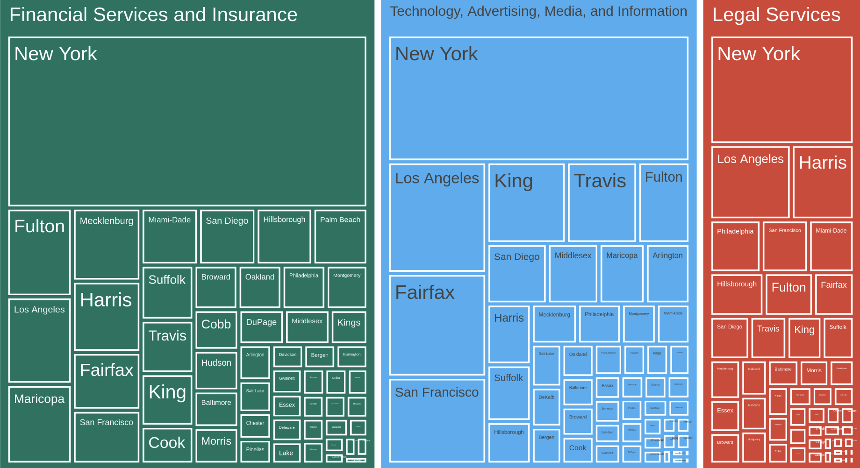
Transaction Counts
Transaction Counts by Year and Industry in Miami-Dade County
Financial services
Technology
Legal
Others
Rapid growth in Financial Services and Legal sectors transaction counts, alongside a steady increasing trend in the Technology field.
Treemap of Transaction Counts by Industry and County
Miami-Dade County is listed as the top 10 Counties in terms of their transaction counts in the Financial industry.
Notes:
Map & transaction count versus time

Slide 4
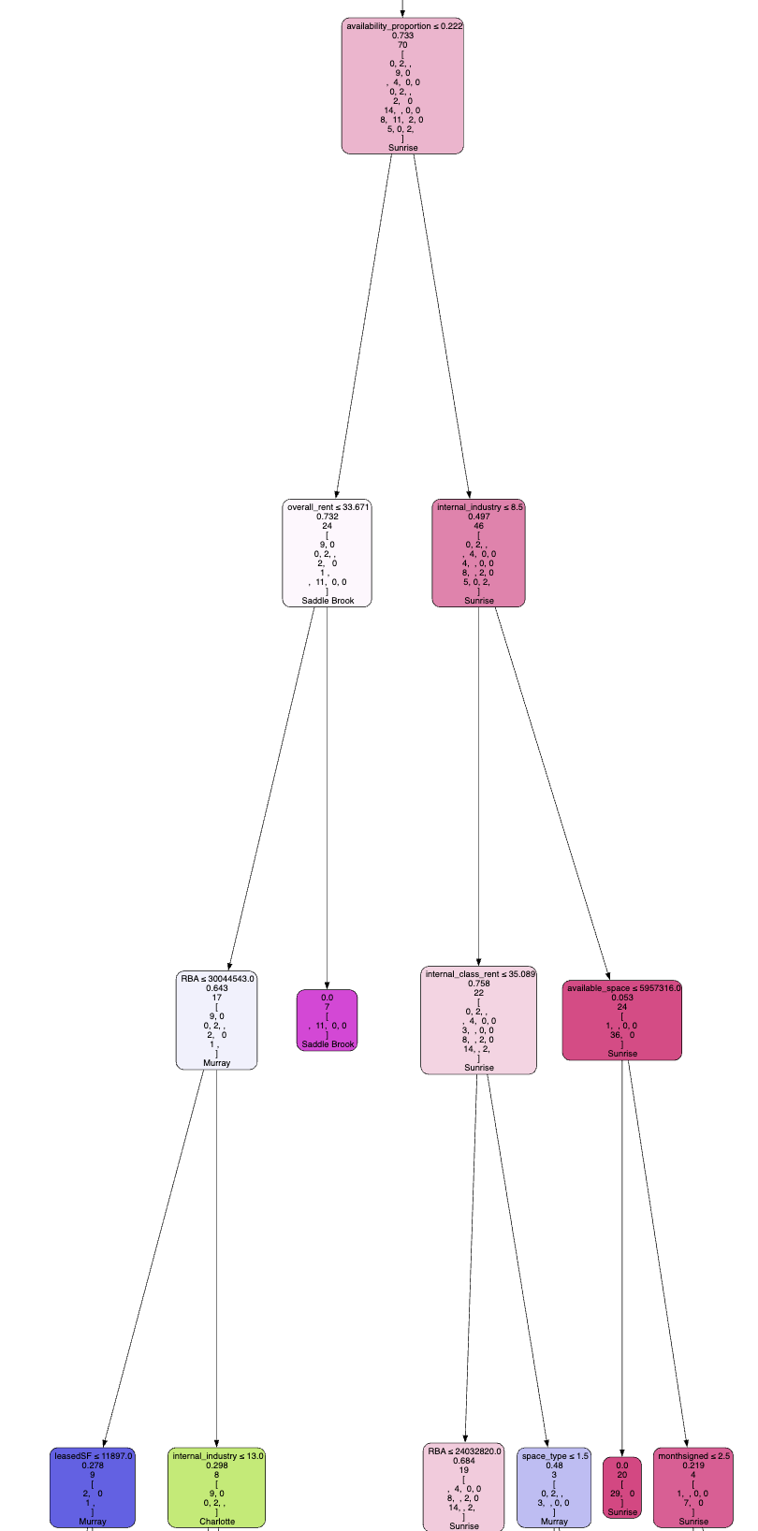
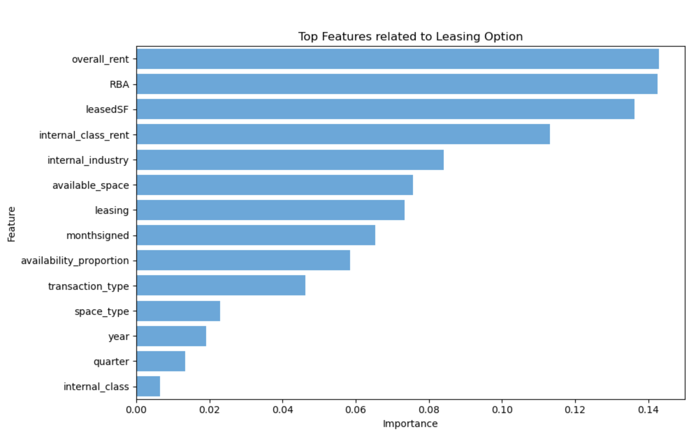

Transaction Type: New
Top Features Related to Leasing Options
Top 10 Factors:
Overall rent
Rentable Building Area (square feet)
Leased Square Feet
Industry Sector
Available Space
Leasing Activity
Month Lease Signed
Availability Proportion
Transaction Type
Space Type
Year
Quarter
Building Quality
Decision Tree Demo Example
Industry Type: Tech
Industry Type: Non-Tech
Rent:
≥ $33/h
Rent:
< $33/h
…
Accuracy score: 0.925
Charlotte

